Slide 1


Discover the World through Instagram 🌎
Instagram is more than just a photo-sharing platform, it's a place to explore the world. From breathtaking landscapes to diverse cultures, Instagram brings the world to your fingertips. Join us on a journey through the lens of Instagram.
by Junaid Fastpwr

Slide 2
History of Instagram
1
2010 - The Beginning
Instagram was founded by Kevin Systrom and Mike Krieger as a photo- sharing app exclusively for iOS users.
2012 - Facebook Acquisition
Facebook acquired Instagram for $1 billion, extending its reach to over 400
million users.
2
3
2015 - Expansion
Instagram opened up to Android users and introduced new features such as videos, direct messaging, and paid advertising.
2020 - Reels and Beyond
Instagram launched Reels, a short-form video feature, and continues to grow as a platform for creators, businesses, and
influencers.
4

Slide 3
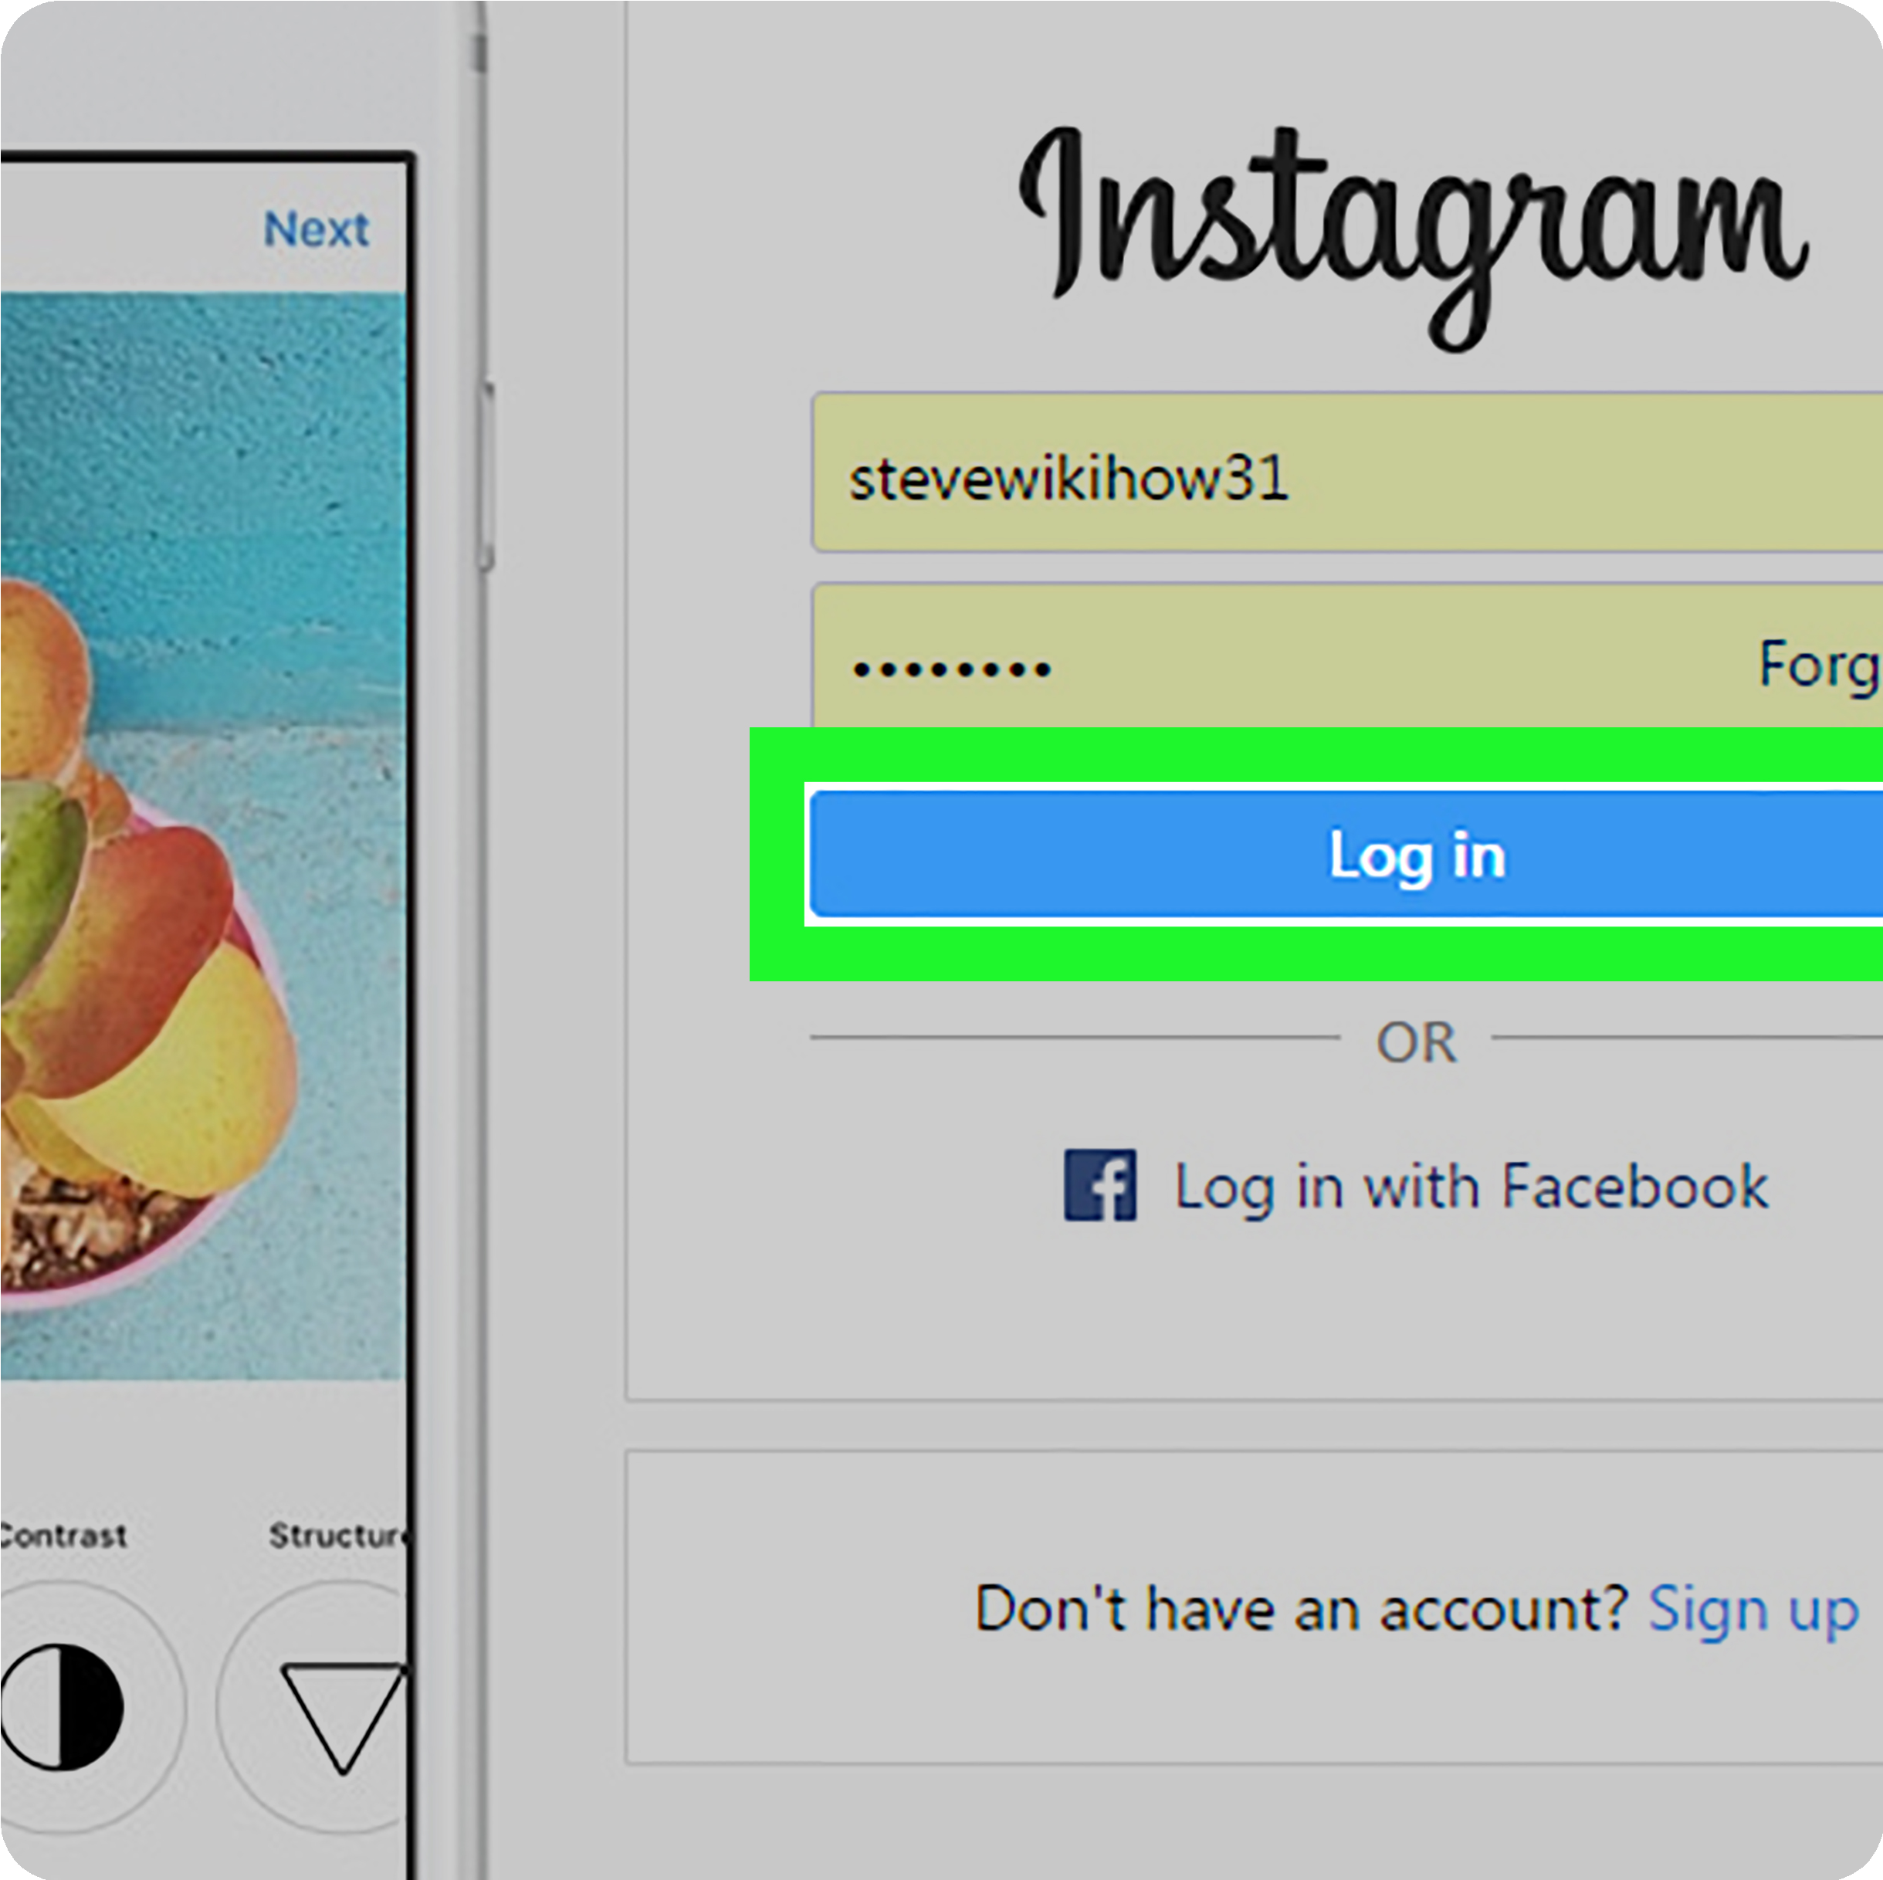
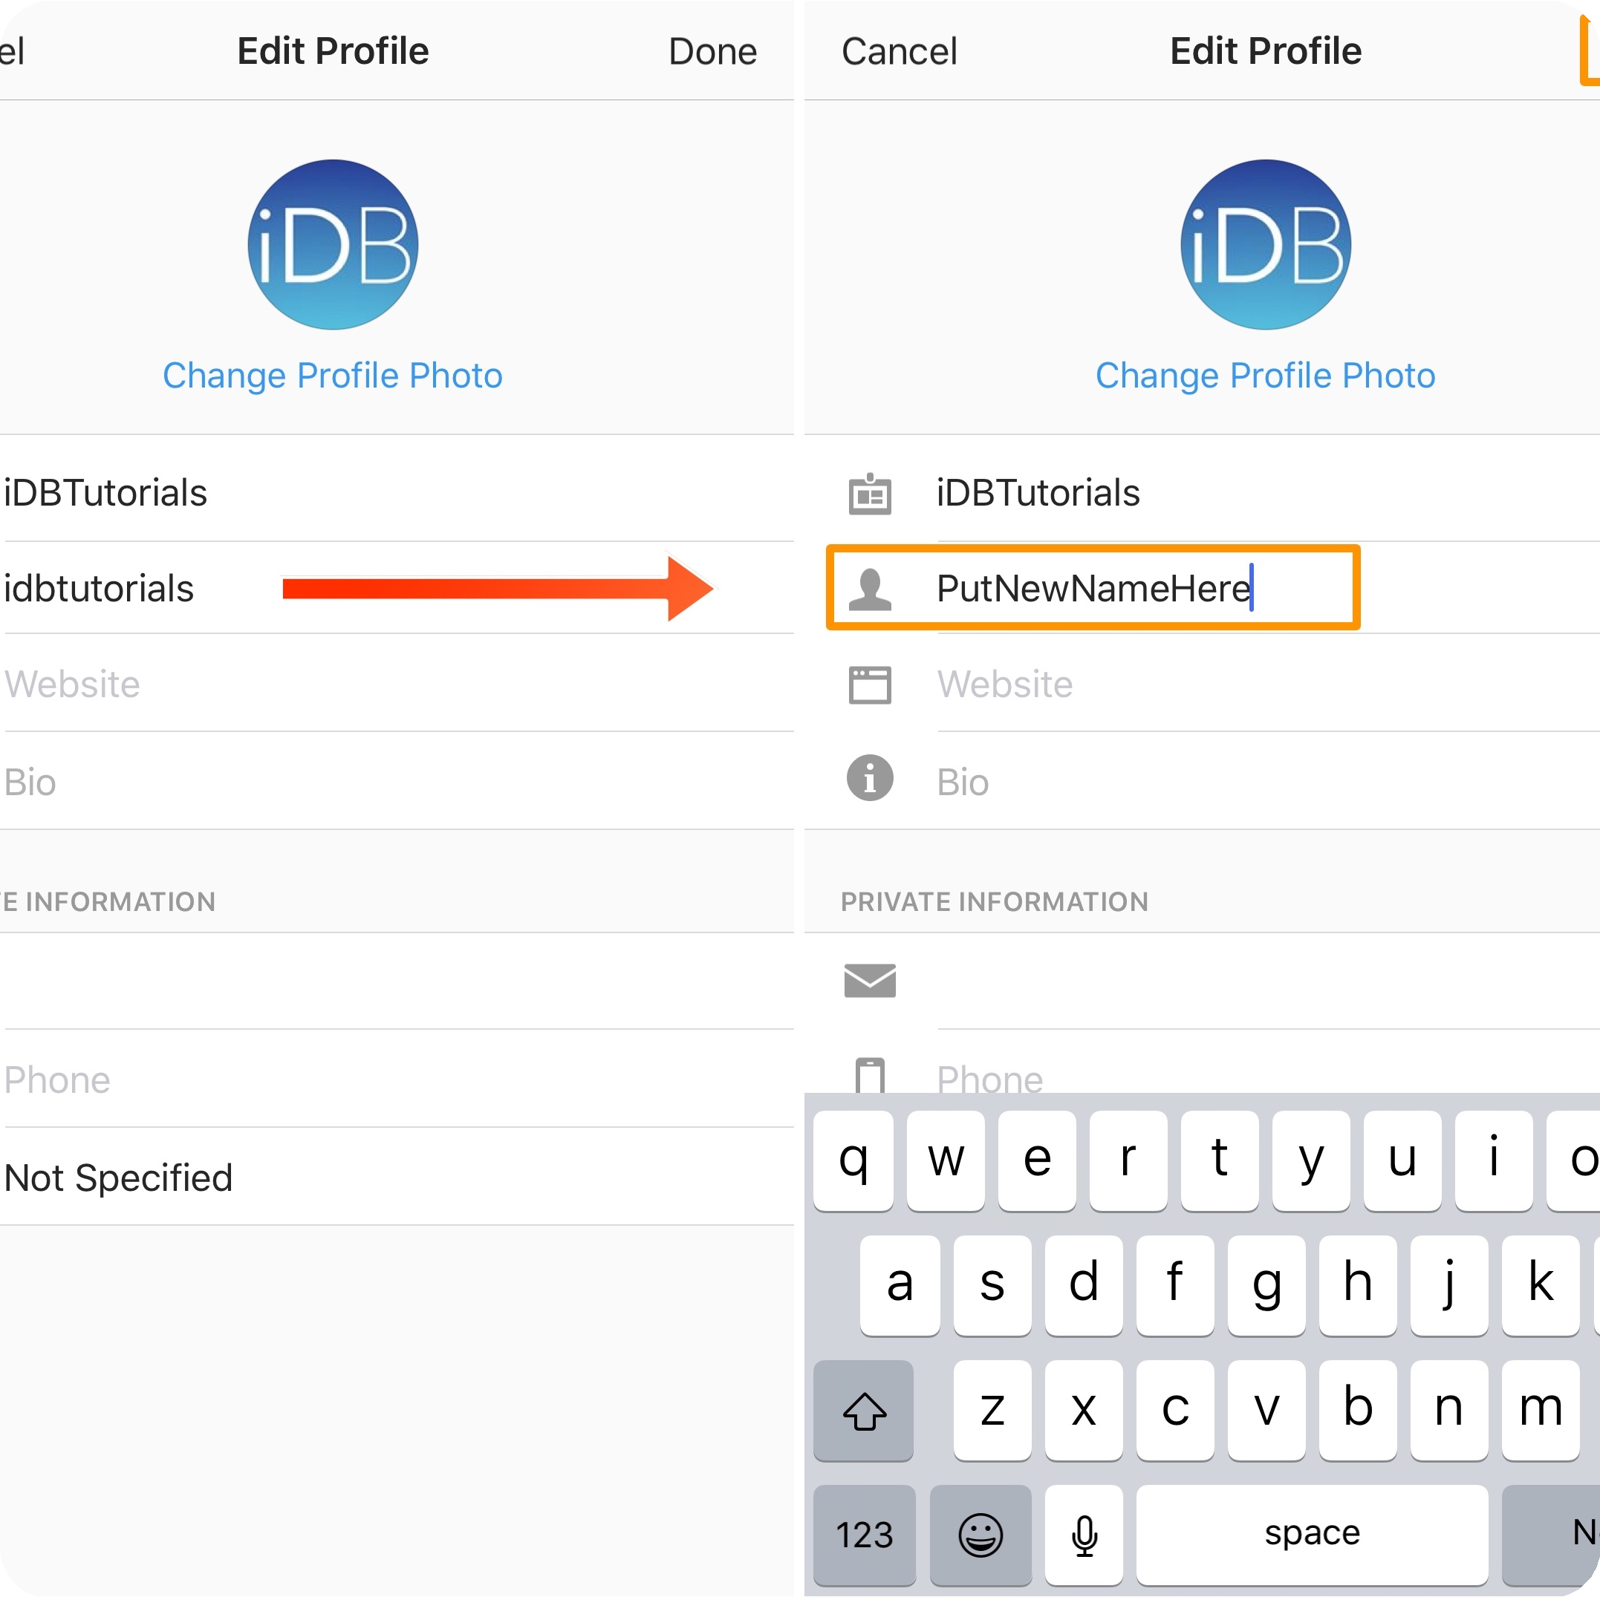

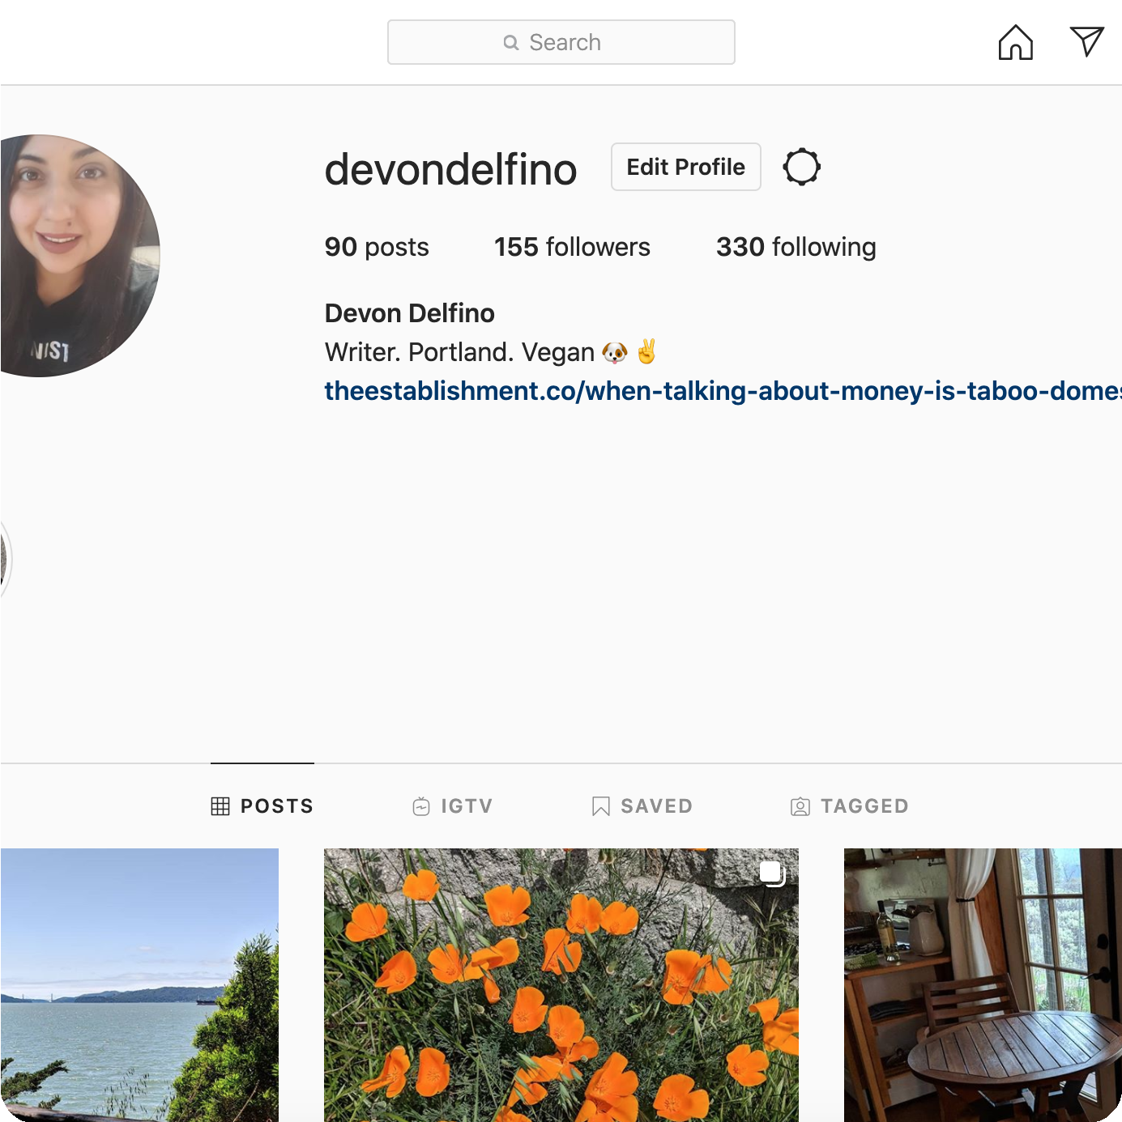
Creating an Instagram Account
Homepage
Go to instagram.com or download the app and click on "Sign Up".
Email or Username
Enter your email or username and create a strong password.
Profile Picture
Upload a clear and representative profile picture that reflects your brand or personality.
Bio
Add a brief and catchy bio that tells visitors what you or your business is all about.

Slide 4
Posting on Instagram
Quality Content
Post high-quality photos and videos that are relevant and engaging to your audience.
Hashtags
Use relevant hashtags that will help your content reach a wider audience and increase engagement.
Captions
Write creative and descriptive captions that add value to your content and encourage engagement.
Stories and Reels
Take advantage of Instagram's features such as Stories and Reels to showcase behind-the- scenes content and fun, short-form videos.

Slide 5
Instagram Marketing for Businesses
Content Strategy
Create a content strategy with a mix of promotional and non-promotional content that aligns with your brand's identity.
1
2
3
Define Your Audience
Identify your target audience and tailor your content to their interests and preferences.
Influencer Marketing
Partner with influencers who align with your brand and have a strong following to reach new audiences.

Slide 6

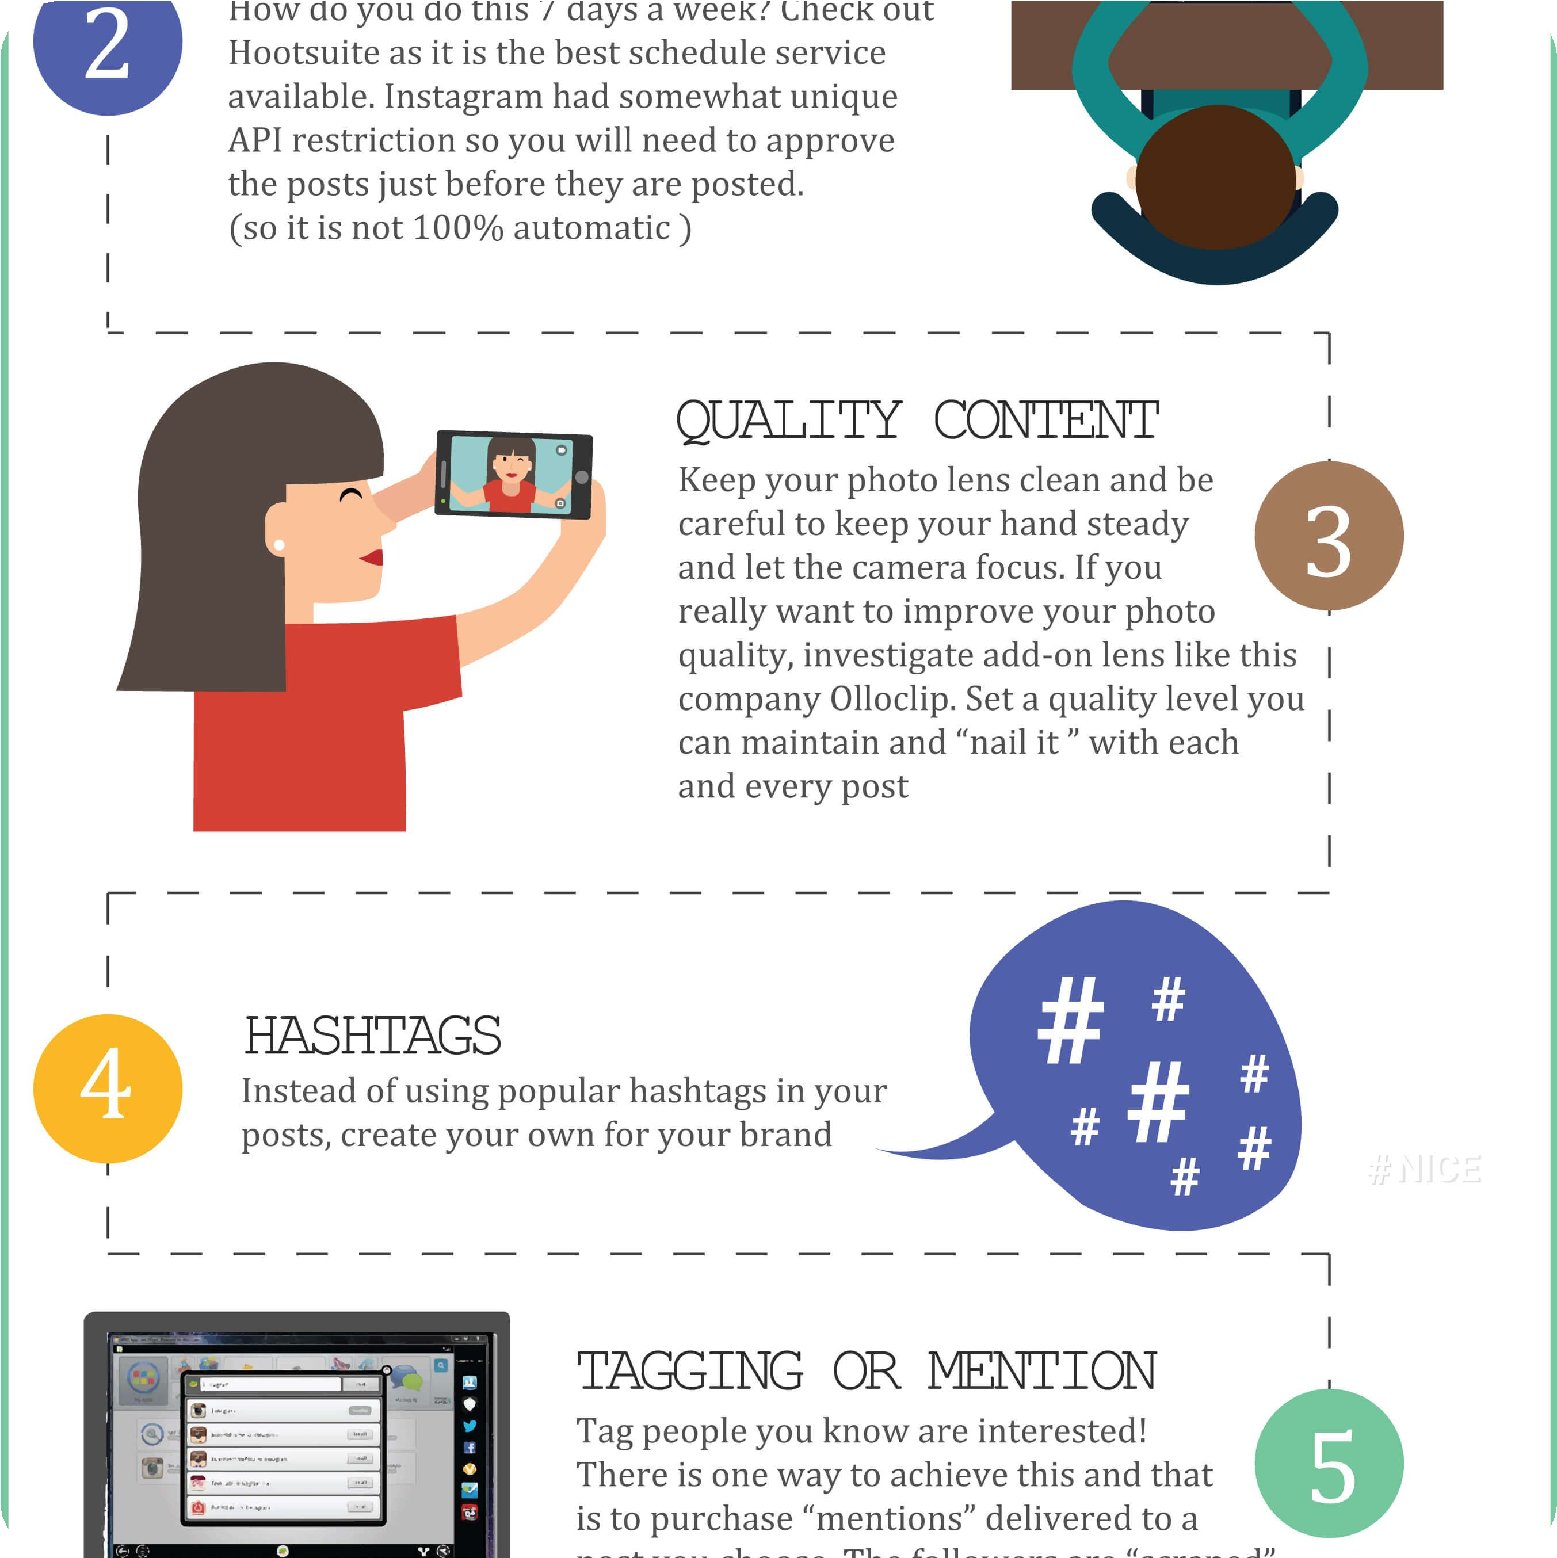
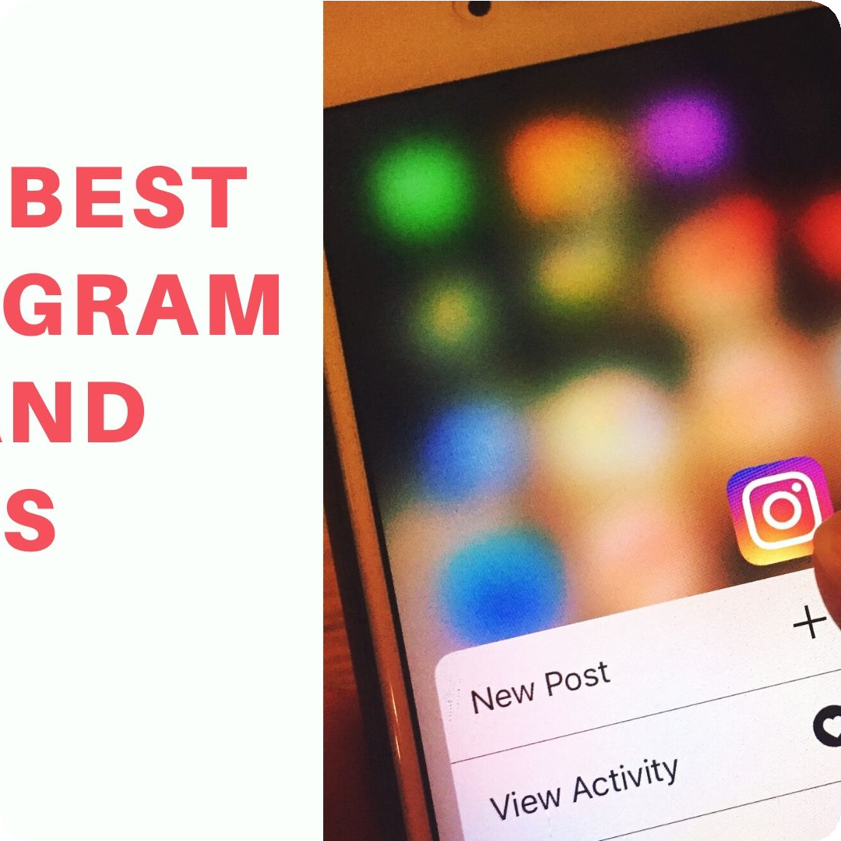
Tips for Using Instagram Effectively
Increase Engagement
Engage with your followers by responding to comments and direct messages, hosting giveaways, and collaborating with other users.
Track Analytics
Use Instagram's built-in analytics to track metrics such as engagement, reach, and profile visits to adjust your content strategy.
Video Content
Experiment with video content such as IGTV and Reels to boost engagement and reach new audiences.

Slide 7
Success Stories
Glossier
Makeup brand Glossier has built a strong brand identity on Instagram through user- generated content, stories, and influencer partnerships, reaching over 3.9 million followers.
Nike
Nike's inspiring and motivational content has earned them over 151 million followers on Instagram, making them one of the top brands on the platform.
Burrow
Furniture brand Burrow has successfully used Instagram to showcase their product line and connect with their audience, resulting in a 40% increase in revenue.

Slide 8
Frequently Asked Questions
How do I change my Instagram username?
Go to your profile and click "Edit Profile". Under "Username", type in your new username and click "Done".
How do I delete a post?
Go to the post you want to delete, click the three dots on the top right corner, and select "Delete".
What are the image dimensions for Instagram?
The recommended image dimensions for Instagram posts are 1080px x 1350px.

Slide 9

Tips and Tricks for Instagram
1 2
Instagram Live
Use Instagram Live to connect with your audience in real-time and showcase behind-the-scenes content.
Direct Messages
Use Direct Messages to connect with potential customers or influencers and grow your network.
3
Third-Party Apps
Use third-party apps to schedule posts, track analytics, and create eye-catching content.

Slide 10
Benefits of Instagram
1
Brand Exposure
Instagram's visual nature and broad reach make it an effective platform for building brand awareness and reaching new audiences.
Engagement
Instagram's high engagement rate makes it an effective platform for building relationships with customers and connecting with your audience.
2
3
Opportunities
Instagram provides businesses and creators with unique opportunities such as influencer marketing, sponsored content, and e-commerce integrations.

Slide 11
Conclusion
Connect
Instagram is a powerful tool for connecting with people around the world and exploring different cultures and perspectives.
Create
Whether you're a business owner, influencer, or creator, Instagram provides endless opportunities for creativity and self-expression.
Grow
With its high engagement rates and broad reach, Instagram can help businesses and individuals grow their following and achieve their goals.

